Slide 1
Building Resilient Web APIs with .NET Core 2.1
@neekgreen | Nicholas Myers

Slide 2
Nicholas Myers is a software artisan; he mixes code and creativity to produce software that simplifies complex business problems. Nicholas has over fourteen years experience building quality software in a variety of industries, including electronic publishing, travel management, and both residential and commercial real estate. He is a graduate of the University of South Alabama - *Go Jags*! He is passionate about .NET Core, open source software, and helping developers build better software. As a wannabe-nutritionist, Nicholas spends his downtime cooking, baking, and working out - usually in that order.
@neekgreen | Nicholas Myers

Slide 3
How do I run my applications in a scalable and fault tolerant manner?
https://medium.com/microhq/building-resilient-and-fault-tolerant-applications-with-micro-53b454a8e8eb

Slide 4
How do I actually write applications in a scalable and fault tolerant manner?
https://medium.com/microhq/building-resilient-and-fault-tolerant-applications-with-micro-53b454a8e8eb

Slide 5
Overview
Resiliency 101
Strategies for Building Resilience
.NET Core 2.1 Resiliency Features

Slide 6
Resiliency 101
Strategies for Building Resilience
.NET Core 2.1 Resiliency Features

Slide 7
How would you define resiliency?

Slide 8
Resiliency is the capacity to recover quickly from difficulties, toughness.

Slide 9
The goal of resiliency is to return the application to a fully functioning state after a failure.

Slide 11
Notes:
\

Slide 12
Notes:
\

Slide 14


External
API #1
API
External
API #2

Slide 15
External
API #1
API
External
API #2

Slide 16
A fallacy is a mistaken belief, especially one based on unsound argument.

Slide 17
The network is reliable.

Slide 18
Fallacies of distributed computing
Peter Deutsch and James Gosling
The network is reliable
Topology doesn't change
Latency is zero
There is one administrator
Bandwidth is infinite
Transport cost is zero
The network is secure
The network is homogeneous

Slide 19
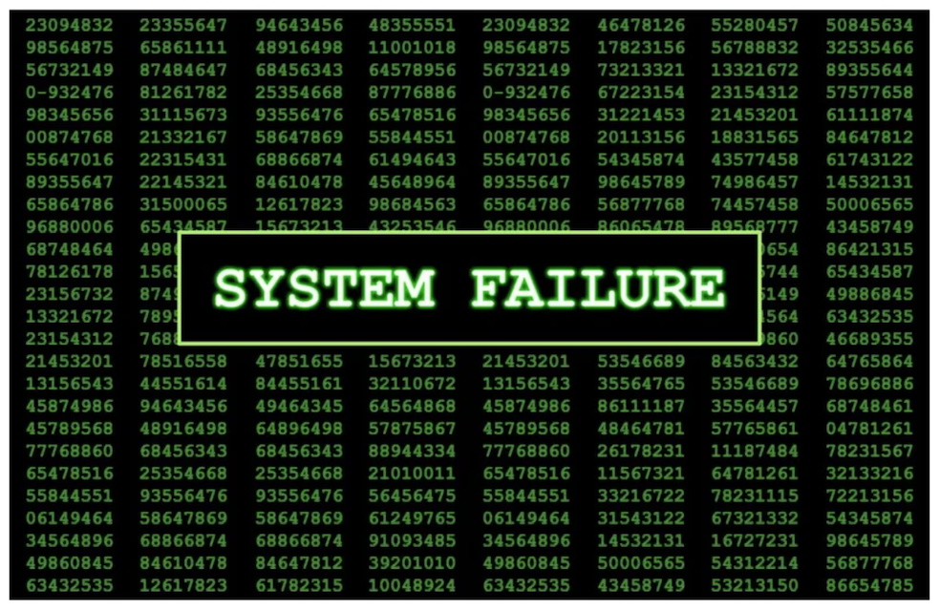
The network is not reliable.

Slide 20
Should our applications have trust issues with network reliability?

Slide 21
It is not about avoiding failures but accepting the fact that failures will happen.

Slide 22
Planning for Failure
Client
Server
Initial connection could fail as the client tries to connect to server.
Call could fail midway while server is fulfilling the operation, leaving the result in limbo.
Call could succeed, but connection breaks before the server can notify client.

Slide 23
Failure is a thing.

Slide 24
A transient error (fault) is a temporary error that is likely to disappear soon.

Slide 25
Would you describe your web application backend as being resilient or fragile?

Slide 26
External
API #1
API
External
API #2

Slide 27
External
API #1
API
External
API #2

Slide 28
Resiliency 101
Strategies for Building Resilience
.NET Core 2.1 Resiliency Features

Slide 29
Transient faults are errors whose cause is expected to be a temporary condition such as temporary service unavailability or network connectivity issues.

Slide 30
Resiliency and Fault Tolerant Strategies
Reactive
Proactive

Slide 31
Retry Strategy
Make Request
Yes
Retry?
No
OK?
No
Return Response

Slide 32
Wait and Retry Strategy
Wait
Make Request
Yes
Retry?
No
OK?
No
Return Response

Slide 33
Timeout Strategy
Make Request
Yes
Slow?
Fail
No
Return Response

Slide 34
Circuit Breaker Strategy
Make Request
Return Response

Slide 35
Fallback Strategy
Make Request
No
OK?
Return Custom Response
Yes
Return Response

Slide 37
Resiliency 101
Strategies for Building Resilience
.NET Core 2.1 Resiliency Features

Slide 38
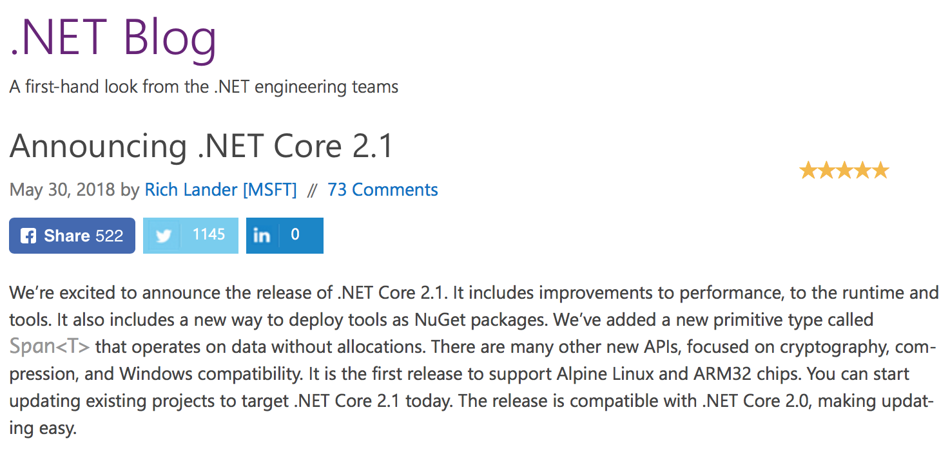
https://blogs.msdn.microsoft.com/dotnet/2018/05/30/announcing-net-core-2-1/

Slide 39
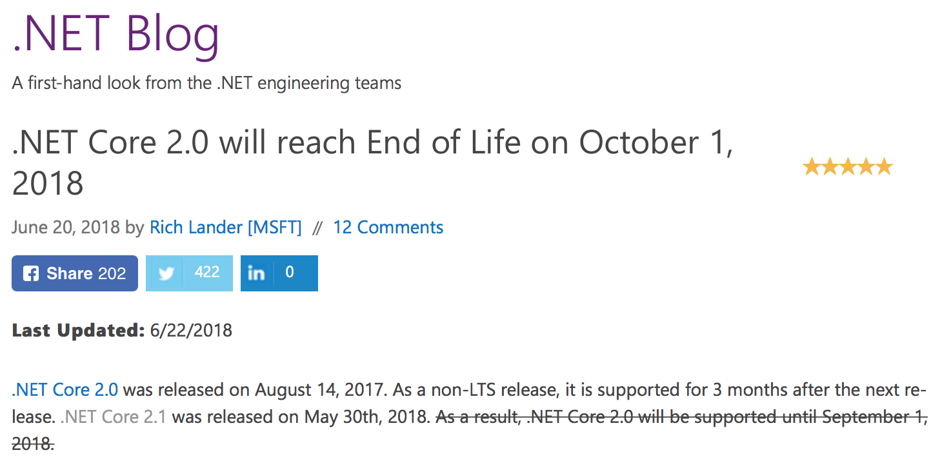
https://blogs.msdn.microsoft.com/dotnet/2018/06/20/net-core-2-0-will-reach-end-of-life-on-september-1-2018/

Slide 41
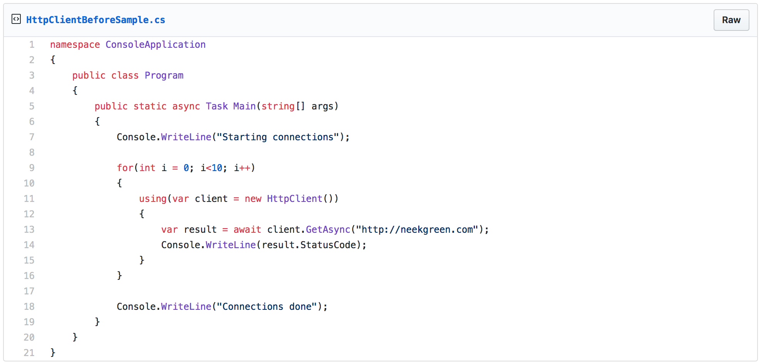

Slide 42
C:\code\testapp>dotnet run Compiling testapp for .NETCoreApp,Version=v2.1 Compilation succeeded. 0 Warning(s) 0 Error(s) Time elapsed 00:00:01.2501667 Starting connections OK OK OK OK OK OK OK OK OK OK Connections done
https://aspnetmonsters.com/2016/08/2016-08-27-httpclientwrong/

Slide 43
C:\code\socket>NETSTAT.EXE
...
Proto Local Address Foreign Address State
TCP 10.211.55.6:12050 waws-prod-bay-017:http TIME_WAIT
TCP 10.211.55.6:12051 waws-prod-bay-017:http TIME_WAIT
TCP 10.211.55.6:12053 waws-prod-bay-017:http TIME_WAIT
TCP 10.211.55.6:12054 waws-prod-bay-017:http TIME_WAIT
TCP 10.211.55.6:12055 waws-prod-bay-017:http TIME_WAIT
TCP 10.211.55.6:12056 waws-prod-bay-017:http TIME_WAIT
TCP 10.211.55.6:12057 waws-prod-bay-017:http TIME_WAIT
TCP 10.211.55.6:12058 waws-prod-bay-017:http TIME_WAIT
TCP 10.211.55.6:12059 waws-prod-bay-017:http TIME_WAIT
TCP 10.211.55.6:12060 waws-prod-bay-017:http TIME_WAIT
TCP 10.211.55.6:12061 waws-prod-bay-017:http TIME_WAIT
TCP 10.211.55.6:12062 waws-prod-bay-017:http TIME_WAIT
...
https://aspnetmonsters.com/2016/08/2016-08-27-httpclientwrong/

Slide 44
Unable to connect to the remote server System.Net.Sockets.SocketException: Only one usage of each socket address (protocol/network address/port) is normally permitted.
https://aspnetmonsters.com/2016/08/2016-08-27-httpclientwrong/

Slide 45
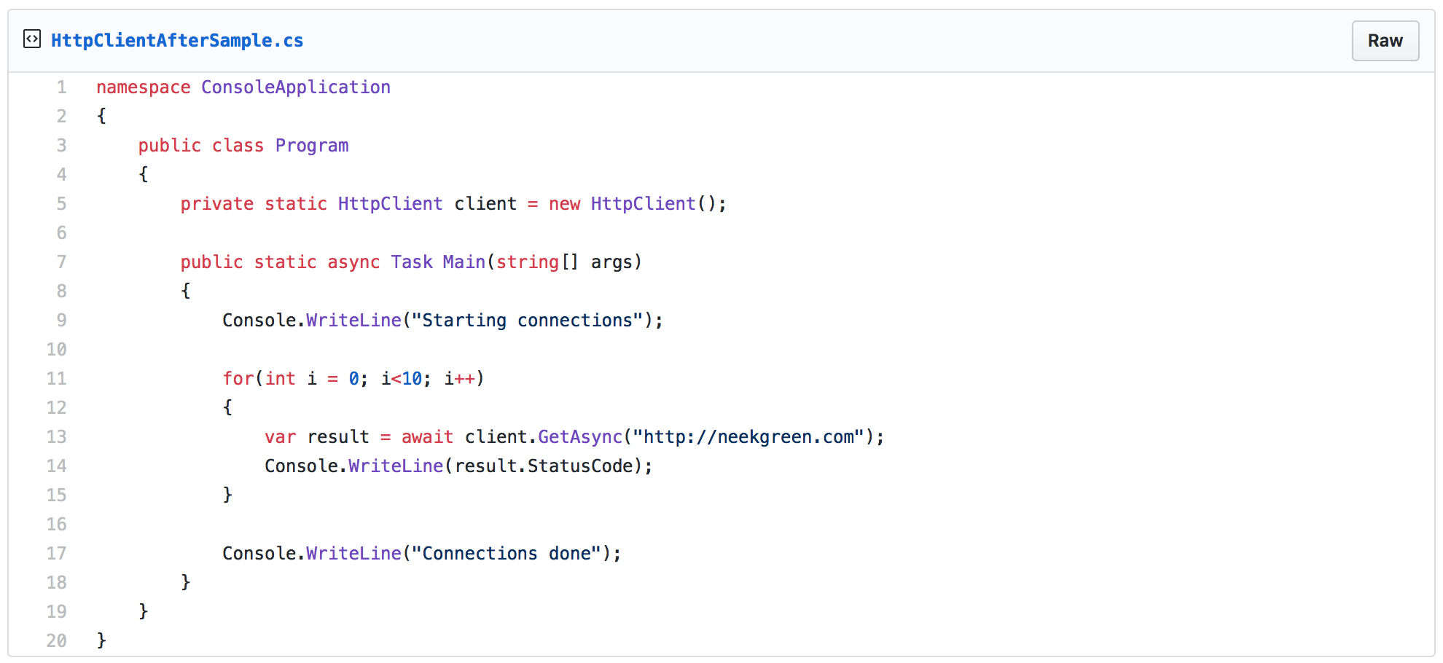

Slide 46
C:\code\testapp>dotnet run Compiling testapp for .NETCoreApp,Version=v2.1 Compilation succeeded. 0 Warning(s) 0 Error(s) Time elapsed 00:00:01.2501667 Starting connections OK OK OK OK OK OK OK OK OK OK Connections done
https://aspnetmonsters.com/2016/08/2016-08-27-httpclientwrong/

Slide 47
C:\code\socket>NETSTAT.EXE
...
Proto Local Address Foreign Address State
TCP 10.211.55.6:12050 waws-prod-bay-017:http TIME_WAIT
...
https://aspnetmonsters.com/2016/08/2016-08-27-httpclientwrong/

Slide 48
https://aspnetmonsters.com/2016/08/2016-08-27-httpclientwrong/

Slide 49
HttpClient is very important in building resilient applications in .NET Core 2.1.

Slide 50
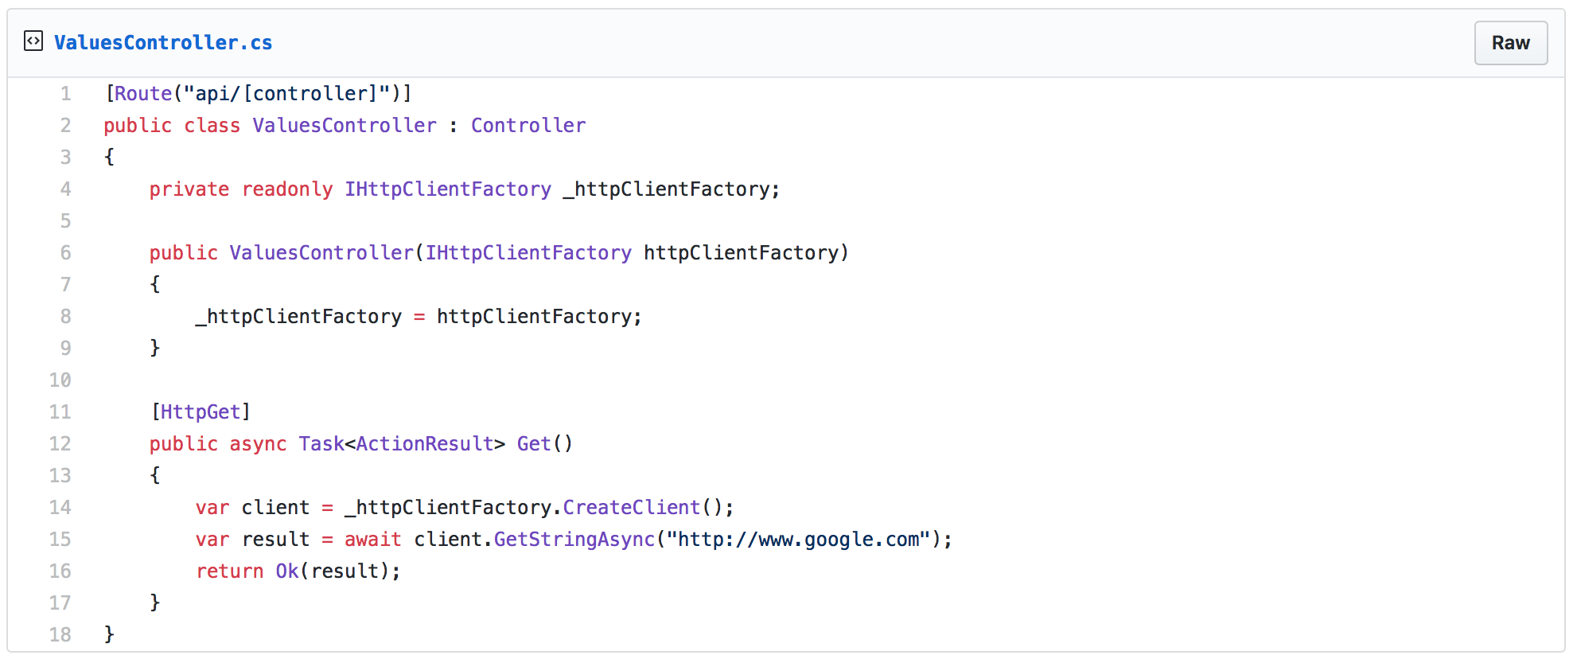
https://www.stevejgordon.co.uk/introduction-to-httpclientfactory-aspnetcore

Slide 51
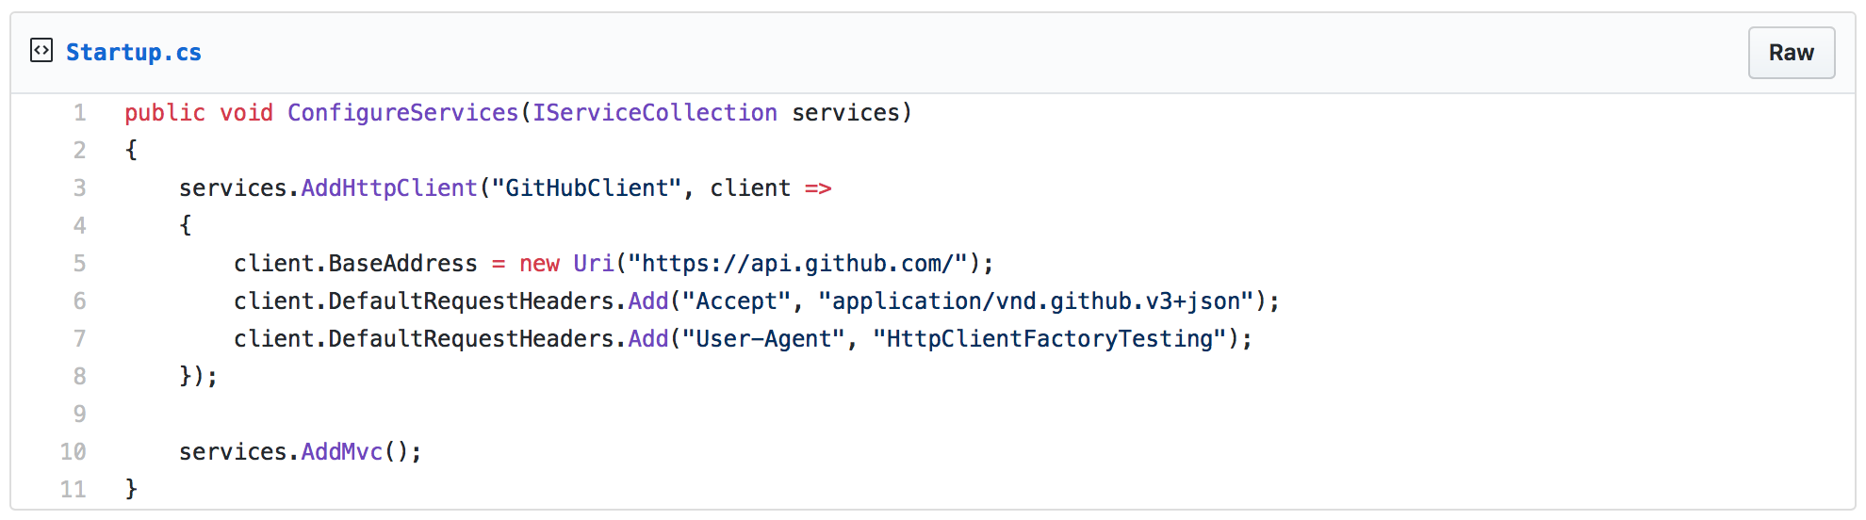
https://www.stevejgordon.co.uk/introduction-to-httpclientfactory-aspnetcore

Slide 52
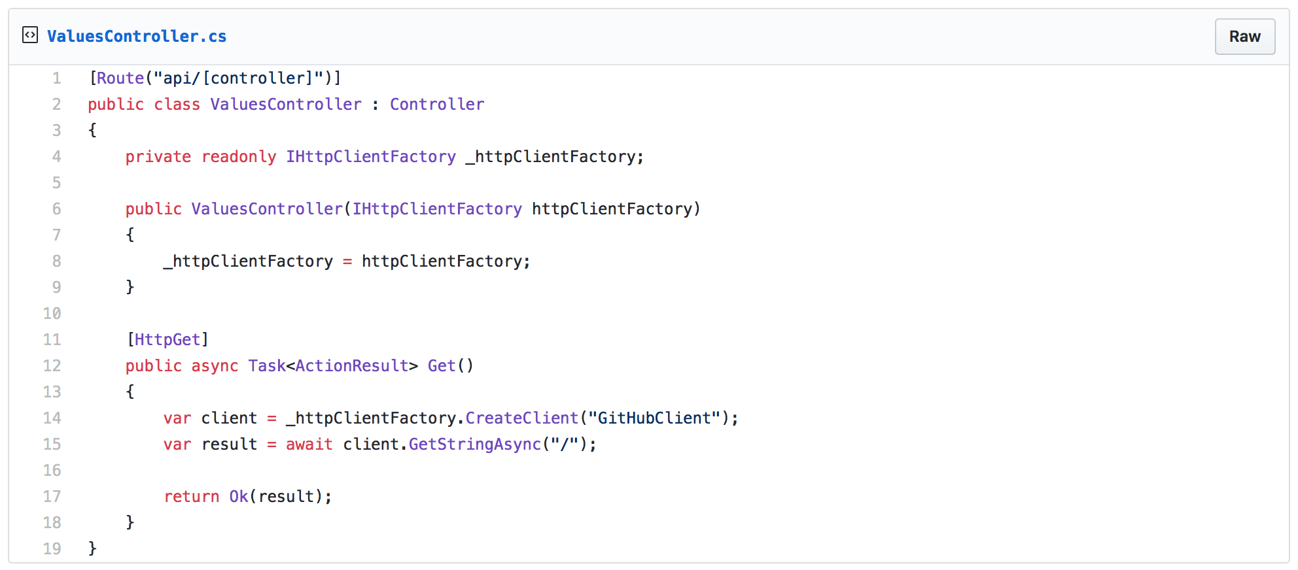
https://www.stevejgordon.co.uk/httpclientfactory-named-typed-clients-aspnetcore

Slide 53
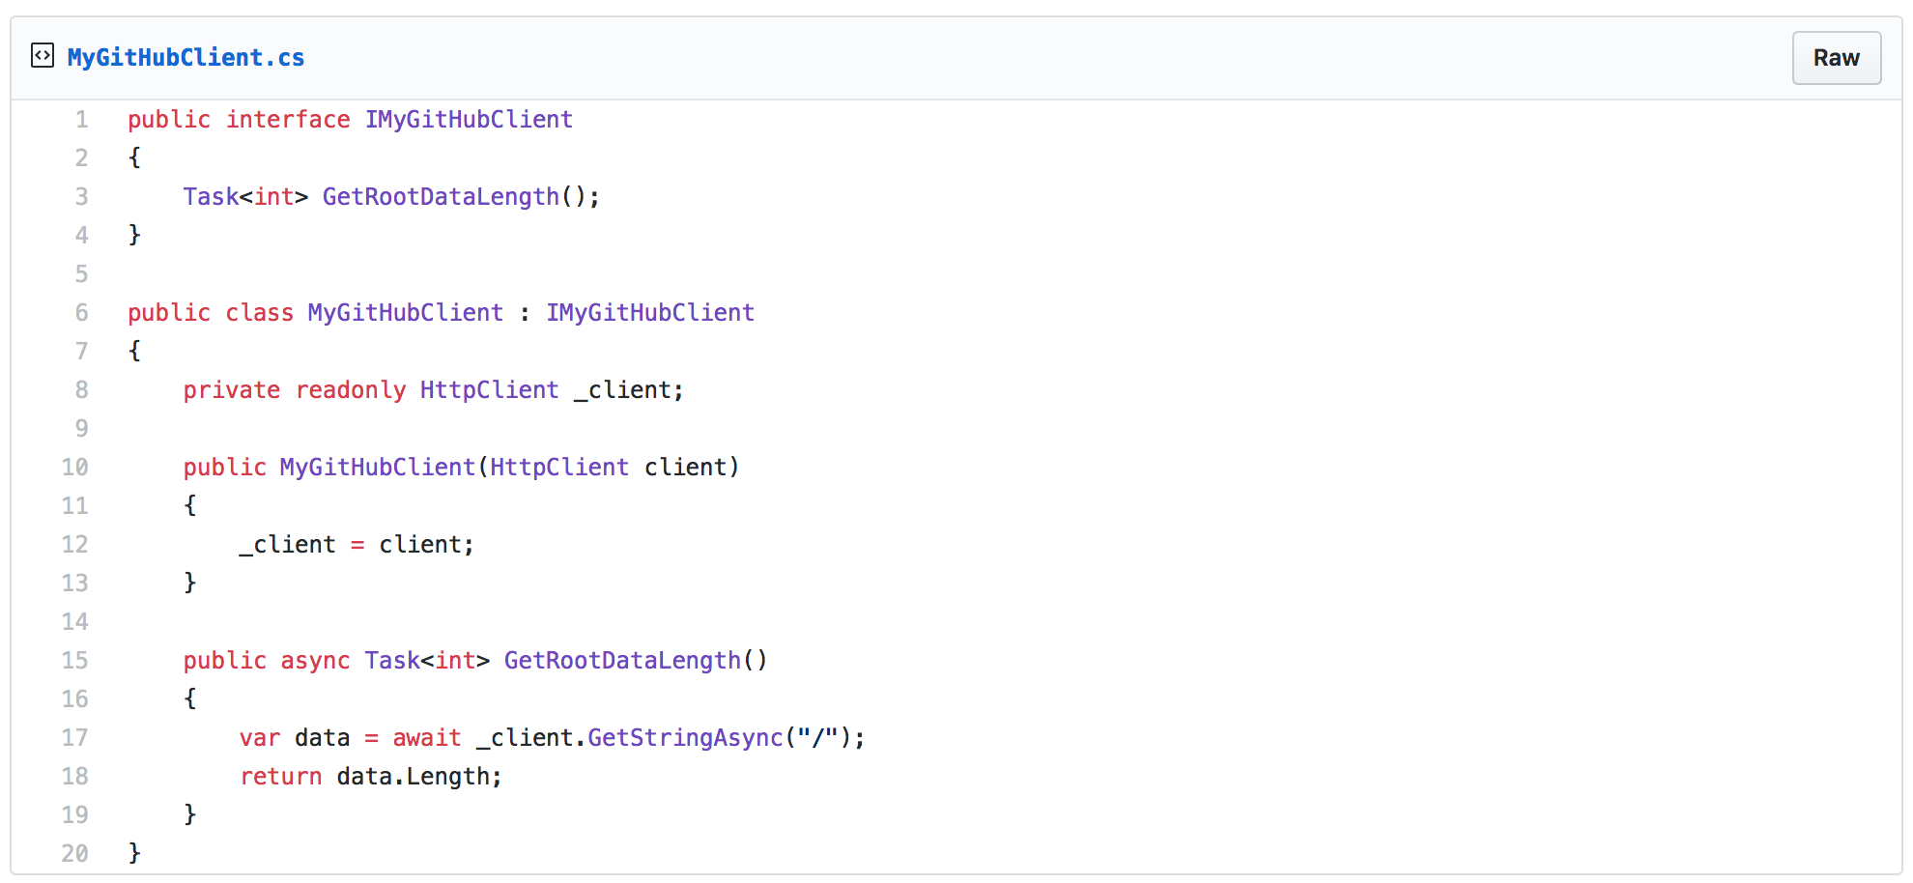
https://www.stevejgordon.co.uk/httpclientfactory-named-typed-clients-aspnetcore

Slide 54
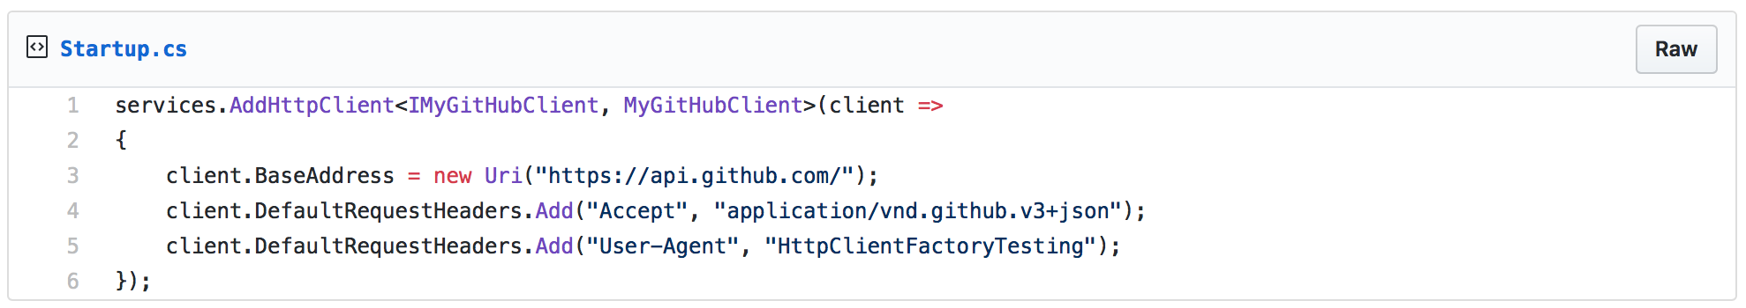
https://www.stevejgordon.co.uk/httpclientfactory-named-typed-clients-aspnetcore

Slide 55
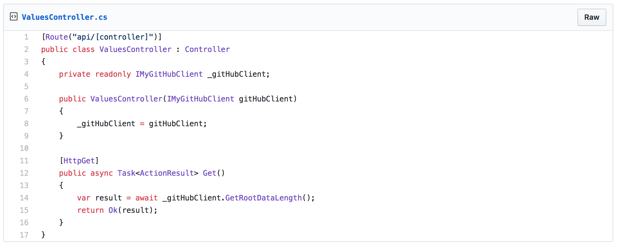
https://www.stevejgordon.co.uk/httpclientfactory-named-typed-clients-aspnetcore

Slide 56
New HttpClient support is awesome, but what about building resiliency in our applications?

Slide 58
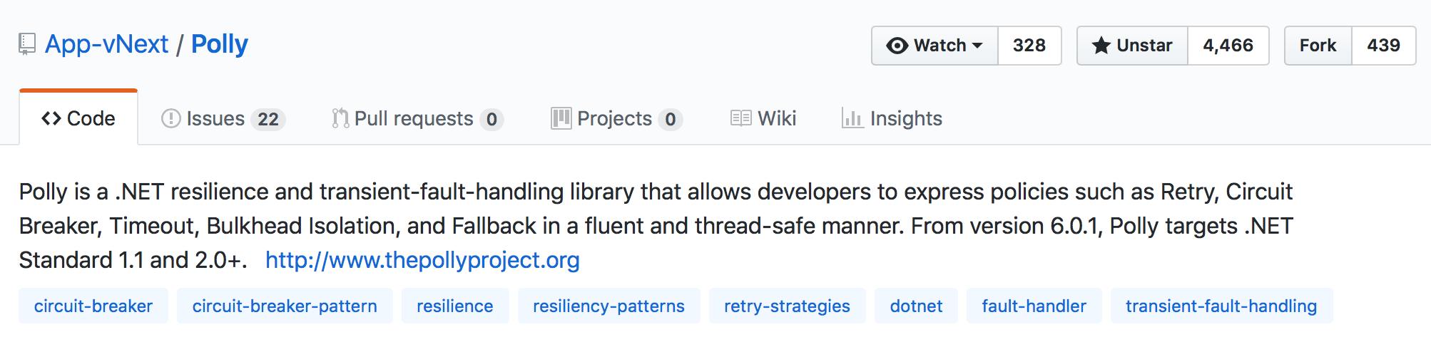

Slide 59
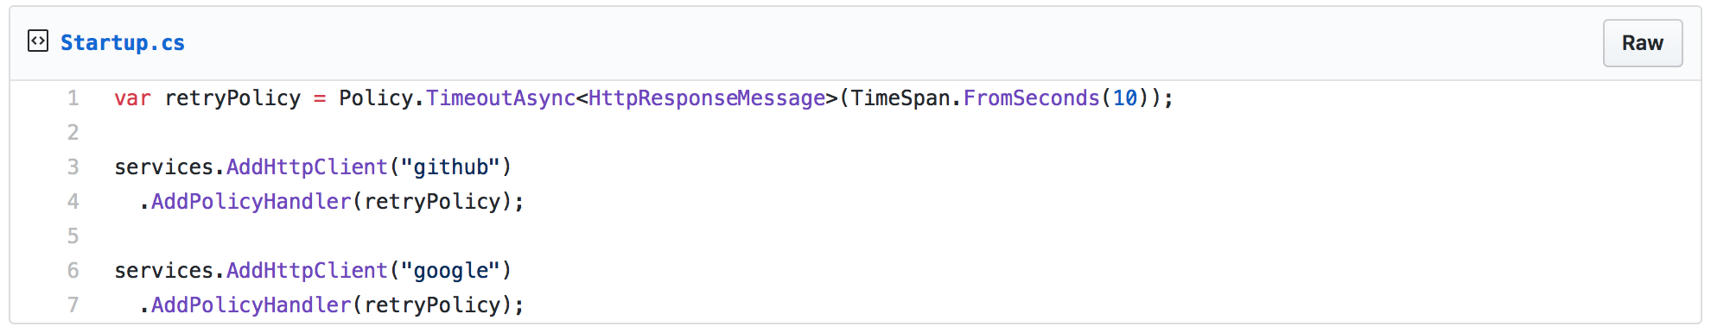
https://www.stevejgordon.co.uk/httpclientfactory-using-polly-for-transient-fault-handling

Slide 60
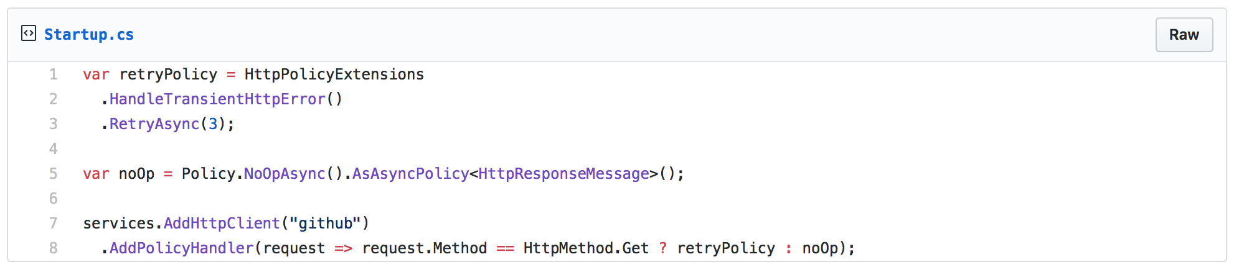
https://www.stevejgordon.co.uk/httpclientfactory-using-polly-for-transient-fault-handling

Slide 61
https://www.stevejgordon.co.uk/httpclientfactory-using-polly-for-transient-fault-handling

Slide 62
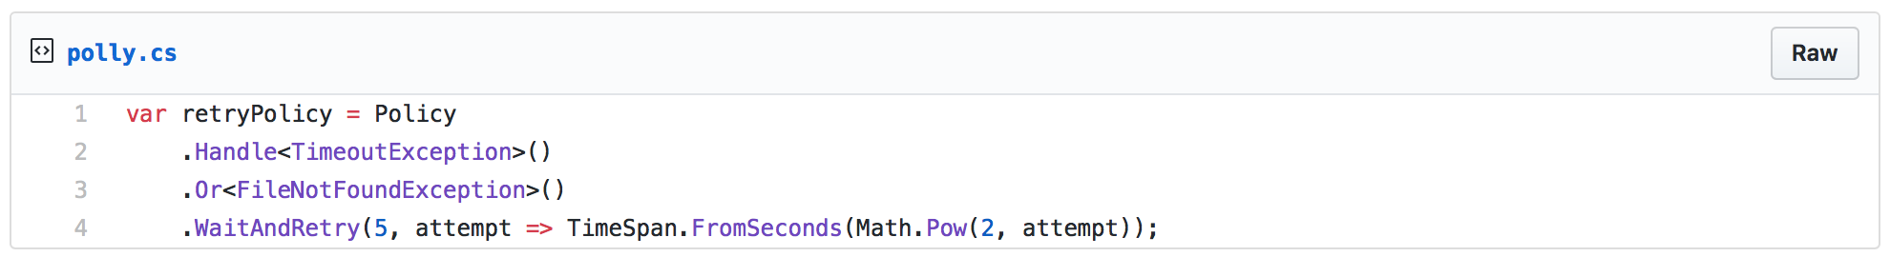
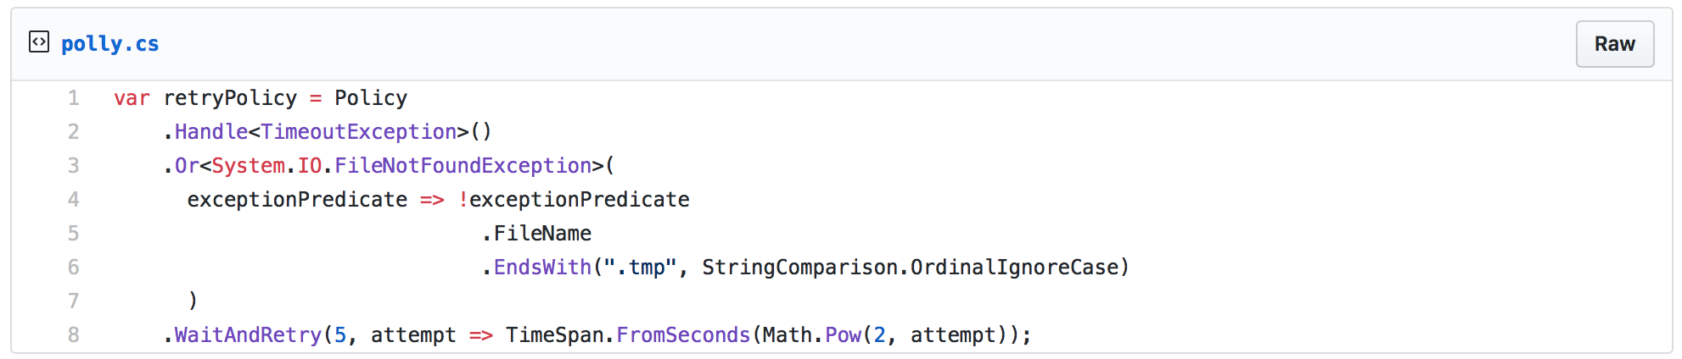
https://hackernoon.com/azure-sql-transient-errors-7625ad6e0a06

Slide 63
There is more to Polly than just providing HttpClient support.

Slide 64
https://hackernoon.com/azure-sql-transient-errors-7625ad6e0a06

Slide 65
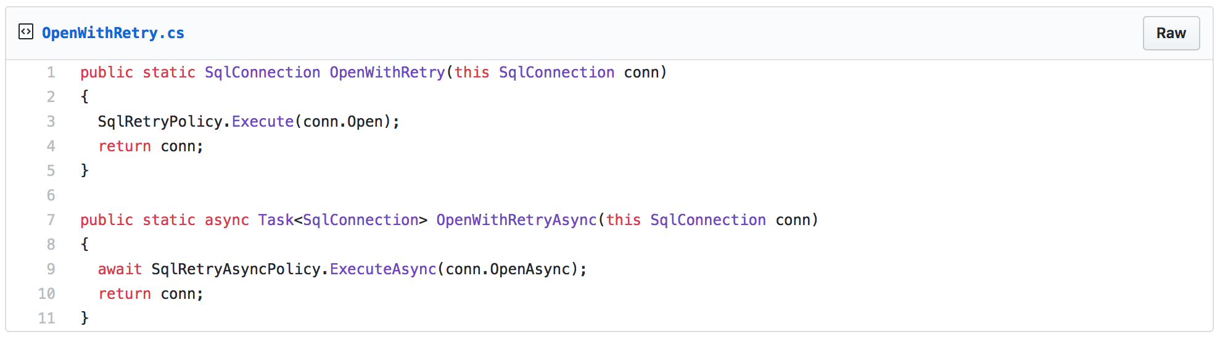
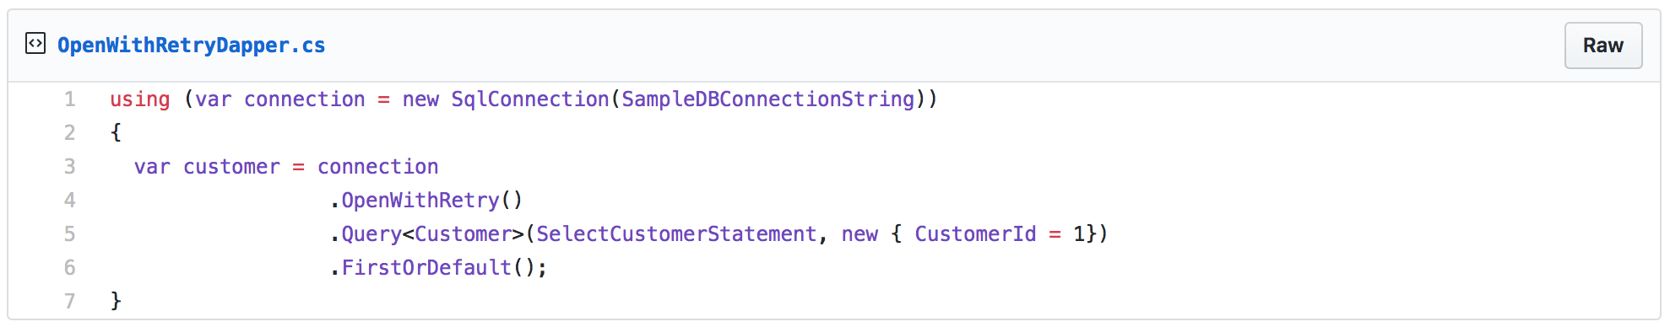

Slide 66
External
API #1
API
External
API #2

Slide 68
Polly
A .NET resilience and transient-fault-handling library
https://github.com/App-vNext/Polly
Refit
The automatic type-safe REST library for Xamarin and .NET
https://github.com/reactiveui/refit

